Slide 1
ENSE 374, Milestone 1
Snow Bird
Zain Abedin
Priscilla Chua
Sana Khan
Raymond Knorr
Ali Rizvi
Li Pan
Notes:
‹#›

Slide 2
(New) Problem definition
Go over our interpretation of the project. The who, what, where of it all
Students and staffs.
Everyone focus on different file section;
Students and staffs need rules for them update the files;
Document management system;
P drive.

Slide 3
(New) Problem definition
Address the extended, revised, and/or new problem definition that our team has come up with
No specific guiding lines for uploading files, it cause extent problems

Slide 4
Empathy map(s)
Admin staff
Technical staff
Students

Slide 5
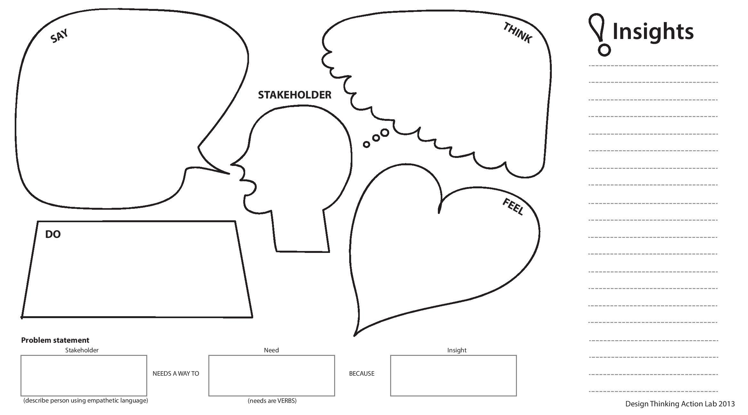
The site should be easier to operate, especially for the people that interact with it the most.
It is difficult teaching everyone where to find everything, and how to use the site.
Admin
Staff
Frustrated, because their time is being wasted
Continue to help everyone with their issues anyway.
More intuitive file systems
Its wasting their time and effort
Admin Staff

Slide 6
“Crowd-sourcing” ideas from students could yield good results
Security levels are tough to properly implement. The project can easily get too complex
Technical Staff
This is a big opportunity for large improvements to the site
Make themselves available to actively help students
The experience could be much more satisfying
Technical Staff
Update the site

Slide 7
It is difficult to come up with a simple, effective solution. Which is why it hasn’t been done yet.
Hard to find relevant information on the site in its current state. Unnecessarily confusing a lot of the time
Students
Unsure of what the correct solution is. It needs to be changed to be more organized
Come up with ideas of how it could be improved. Implement those ideas
Students
Update the sites interface
Is isn’t organized enough for easy use

Slide 8
Revised requirements
Go over your revised requirements
Security issue : who should be given access to the file
Checking file status: Check if the file is outdated and needs an update
There should be a specific guideline for uploading files to the system( If the files are being upload to the right place it will make the system less complex and will require less organizing afterwards)
The folder needs to be specific enough so that there would only be one folder that a given type of file could land in
- This would make it easy to see if that folder already contained an older version of the file, which could be deleted

Slide 9
Address revised (new) user concerns that extend the original narrative based on the analysis of your team’s empathy map(s)
Admins and Students want specific, possibly complicated structure
IT staff want to keep it simple
There will have to be a compromise.

Slide 10
Group reflection
How did you feel about this milestone? What did you like about it? What did you dislike?
[Response here]
What did you learn about yourself as you collaborated and worked through this milestone?
[Response here]
How will you use what you have learned going forward?
[Response here]
What “stuff & things” related to this milestone would you want help with?
[Response here]

